Slide 1



RETROPIE
GAMING CONSOLE ON
RASPBERRY PI
Operating Systems - Lab
SAAD MUGHAL
SHEIKH MUHAMMAD IBRAHIM
KHADIJAH ZAHOOR

Slide 2


WHAT IS
RETROPIE?
RetroPie is a Linux-based operating system that transforms a Raspberry Pi into a retro gaming console by combining emulation software, system services, and hardware abstraction layers.

Slide 3


Problem:
Complex OS concepts are abstract
Hard to visualize hardware-software interaction
WHY THIS
PROJECT?
Solution:
RetroPie provides a real OS
Runs on actual hardware
Shows boot, processes, memory, I/O in action.

Slide 4



User Interface → EmulationStation
Applications → RetroArch & Emulators
SYSTEM
ARCHITECTURE
System Services → systemd, SSH, Samba
Operating System → Raspberry Pi OS
Kernel → Linux (ARM)
Hardware → Raspberry Pi 4

Slide 5




OS CONCEPTS IN ACTION
OS Concept | Where it Appears
Process Management | Emulator processes
Memory Management | RAM & GPU split
I/O Management | Controller + HDMI
File System | ROM directories
Boot Process | Auto-start EmulationStation

Slide 6

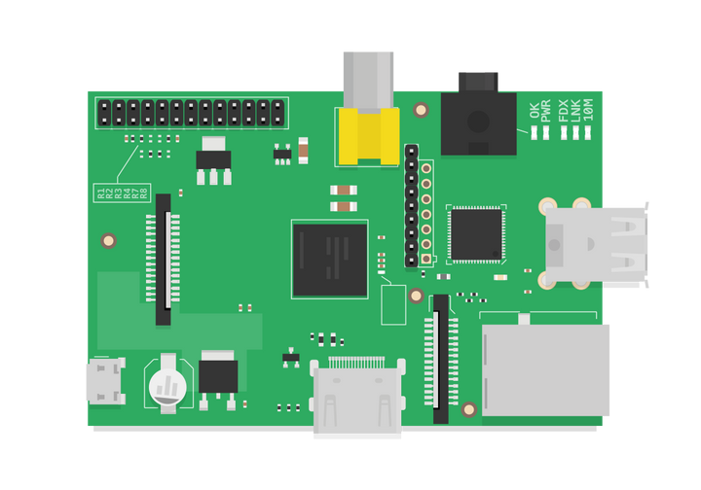

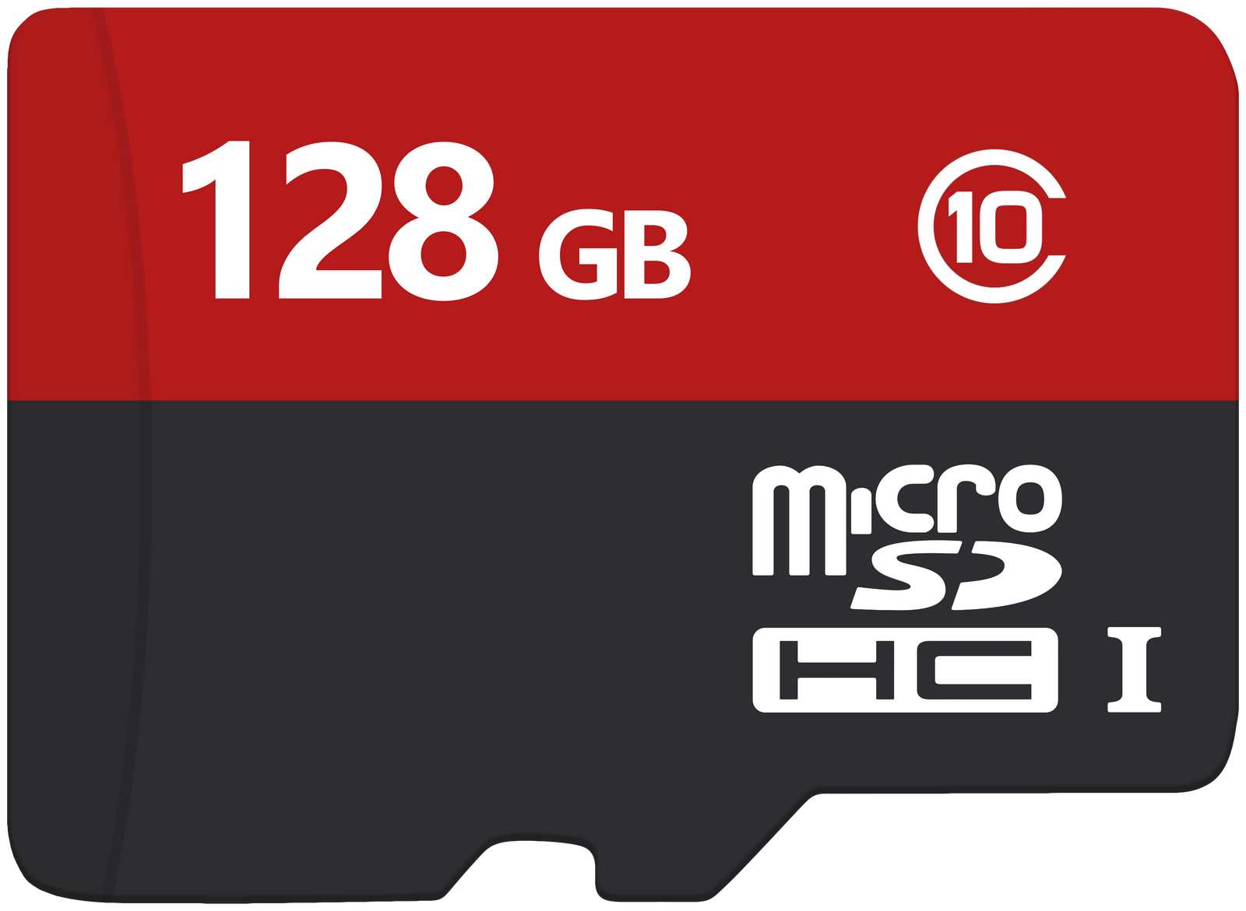





HARDWARE & SOFTWARE STACK
Hardware
Software

Slide 7
INSTALLATION JOURNEY
Flash SD
Network Setup
Image Download
First Boot
Controller Config

Slide 8



ROM & FILE SYSTEM DESIGN
/home/pi/RetroPie/roms/
├── nes/
│ ├── mario.nes
│ └── zelda.nes
├── snes/
│ ├── metroid.smc
│ └── donkey_kong.smc
└── psx/
├── crash_bandicoot.bin
└── final_fantasy.img

Slide 9
REAL
CHALLENGE
FACED
A low-quality microSD card caused OS flashing failures, screen flickering, and unstable gameplay.

Slide 10
ROOT
CAUSE ANALYSIS
LOW-QUALITY
SD CARD
Unstable Read/Write Speeds
DISPLAY FLICKERING & BOOT ISSUES

Slide 11

WHAT WE
LEARNED
This project transformed theoretical operating system concepts into observable system behavior, especially in areas of boot processes, memory allocation, and I/O handling on embedded hardware.

Slide 12


CONCLUSION
Successfully deployed a Linux OS
Demonstrated real OS internals
Linked software behavior with hardware constraints
Gained embedded systems experience

Slide 13




THANK YOU

